Slide 1

Publish to Power Service

Slide 2



Slide 3
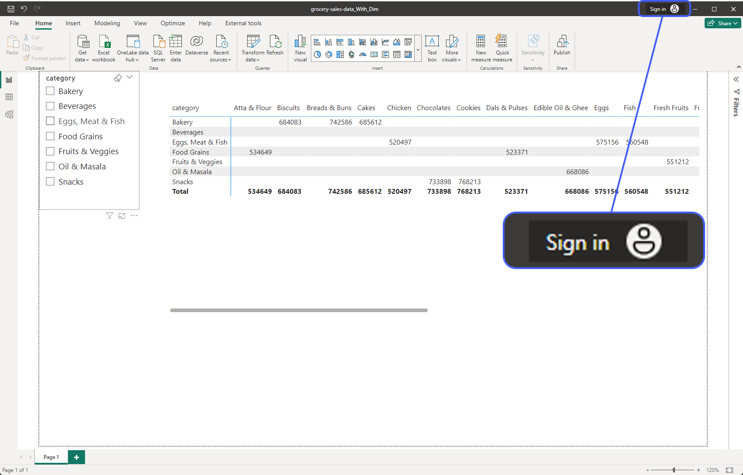
Notes:
First make sure you are signed in. If not signed in then cannot do Publish anywhere

Slide 4
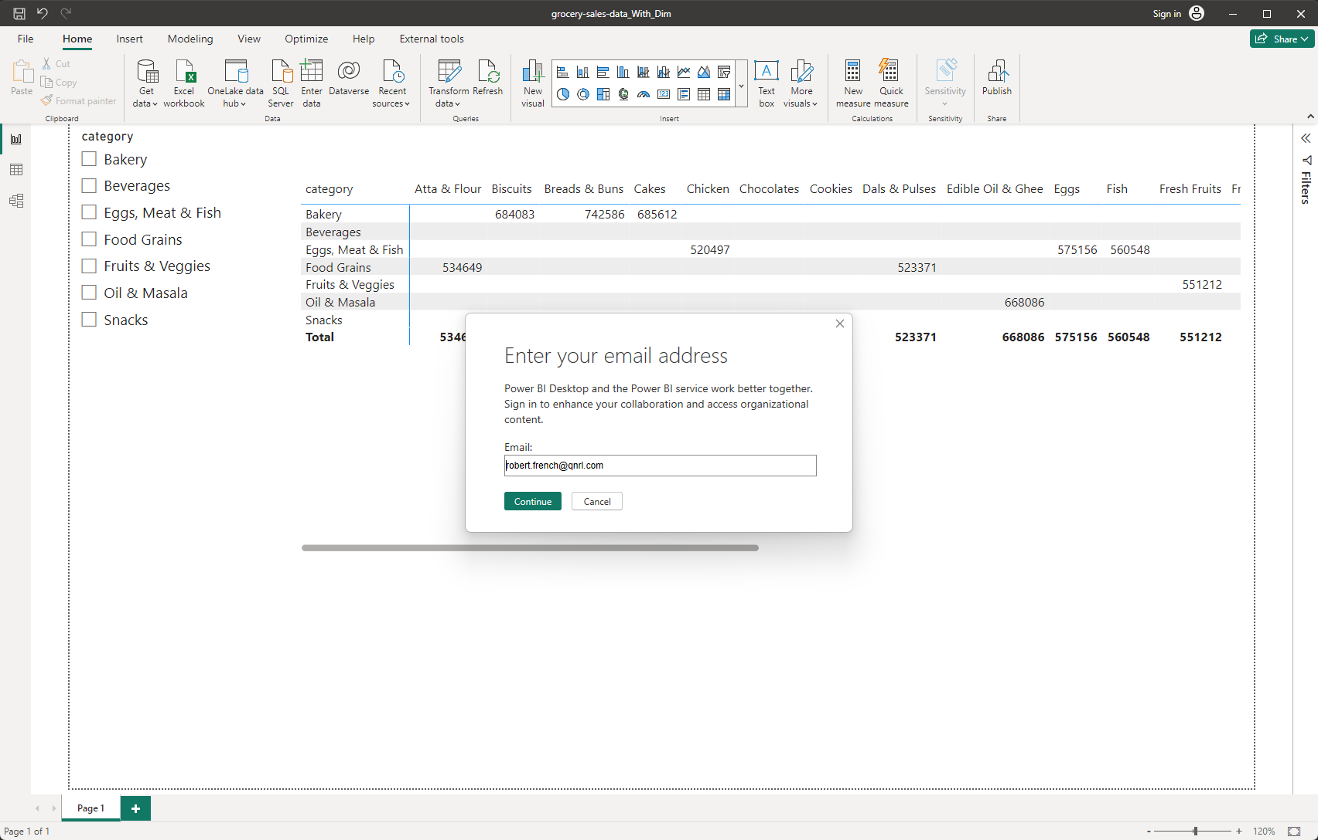

Slide 5
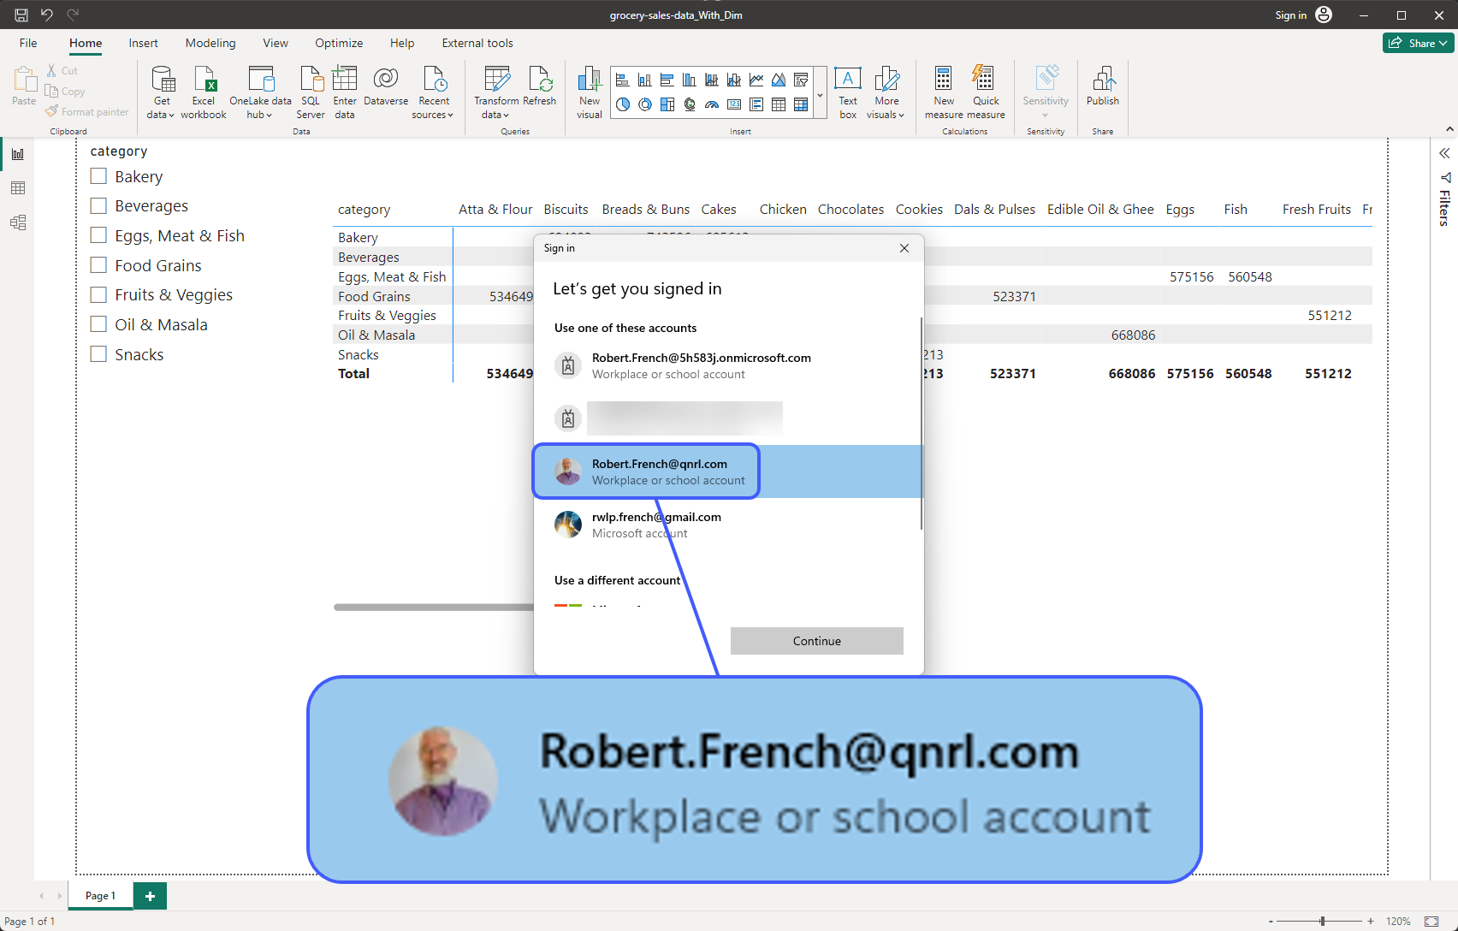

Slide 6
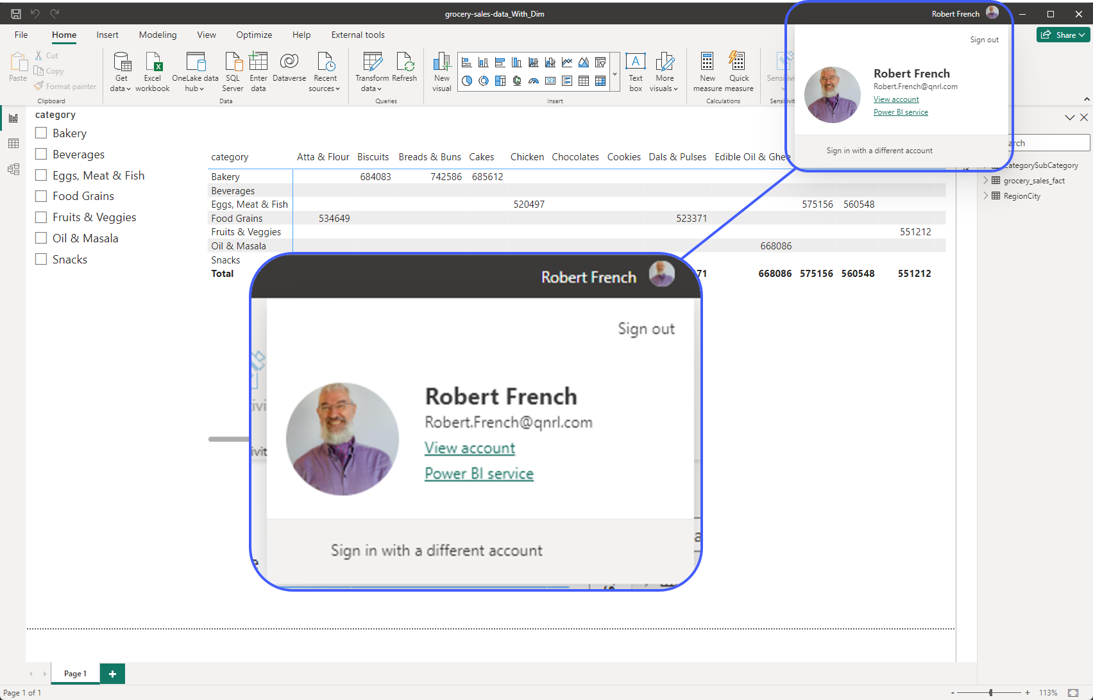

Slide 7
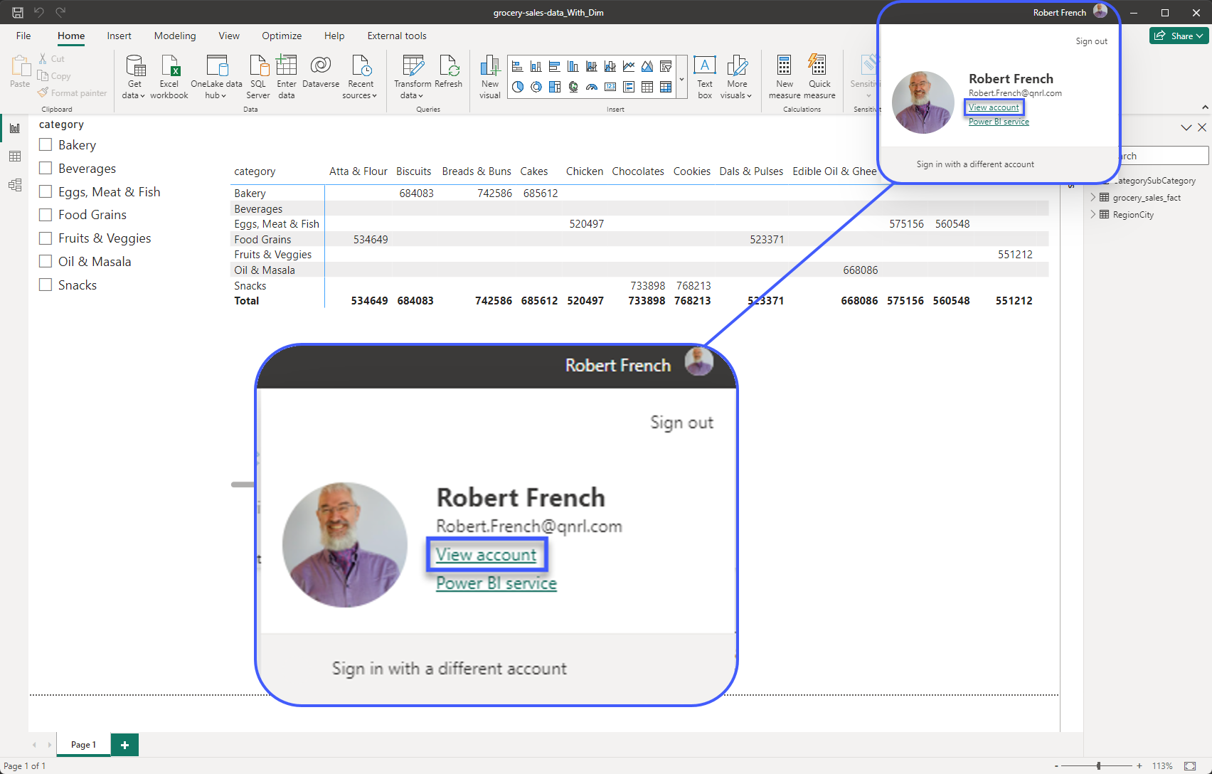

Slide 8
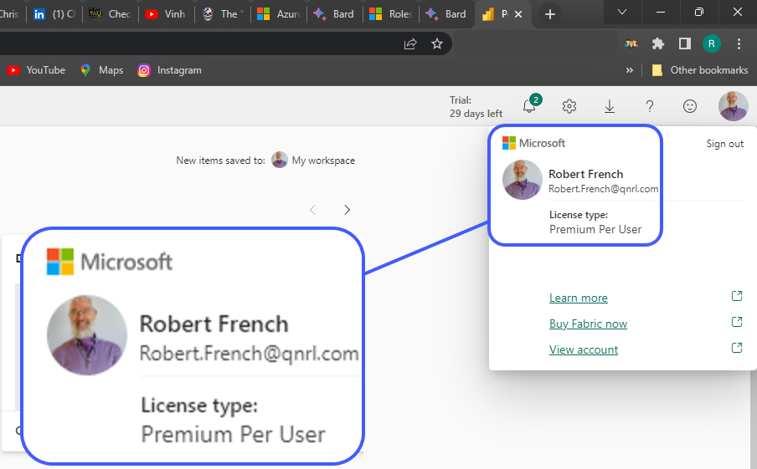

Slide 9
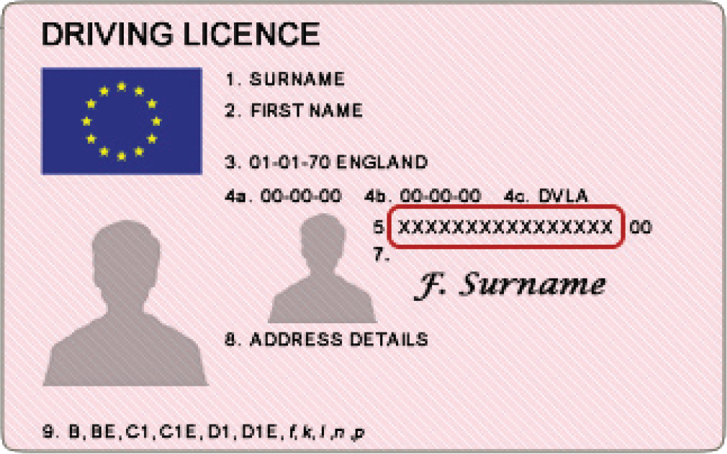
Power BI License Types

Slide 10
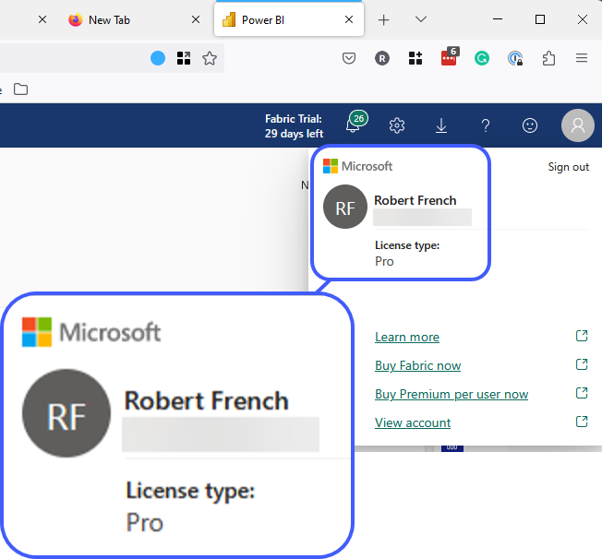

Slide 11
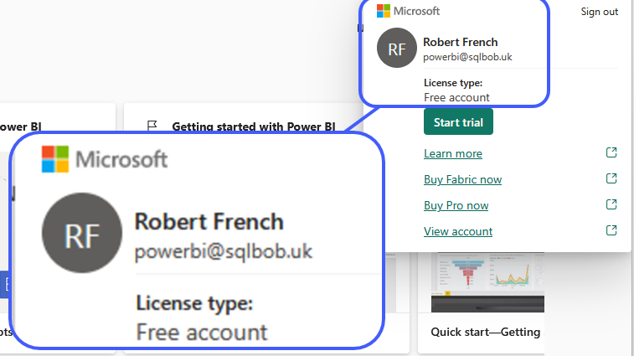

Slide 12
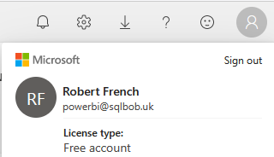

Fabric^{*1} Free License
Cost £0.00
Access to Power BI Service
Publish to My Workspace
Access to other workspaces – It depends
^{*1 – was called Power BI}

Slide 13
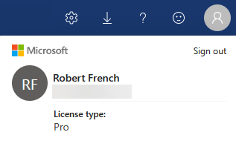
Power BI Pro License
Cost £8.20 per month per user
Access to Power BI Service
Publish to My Workspace
Access to other workspaces
Publish to other workspaces

Slide 14

How to publish

Slide 15
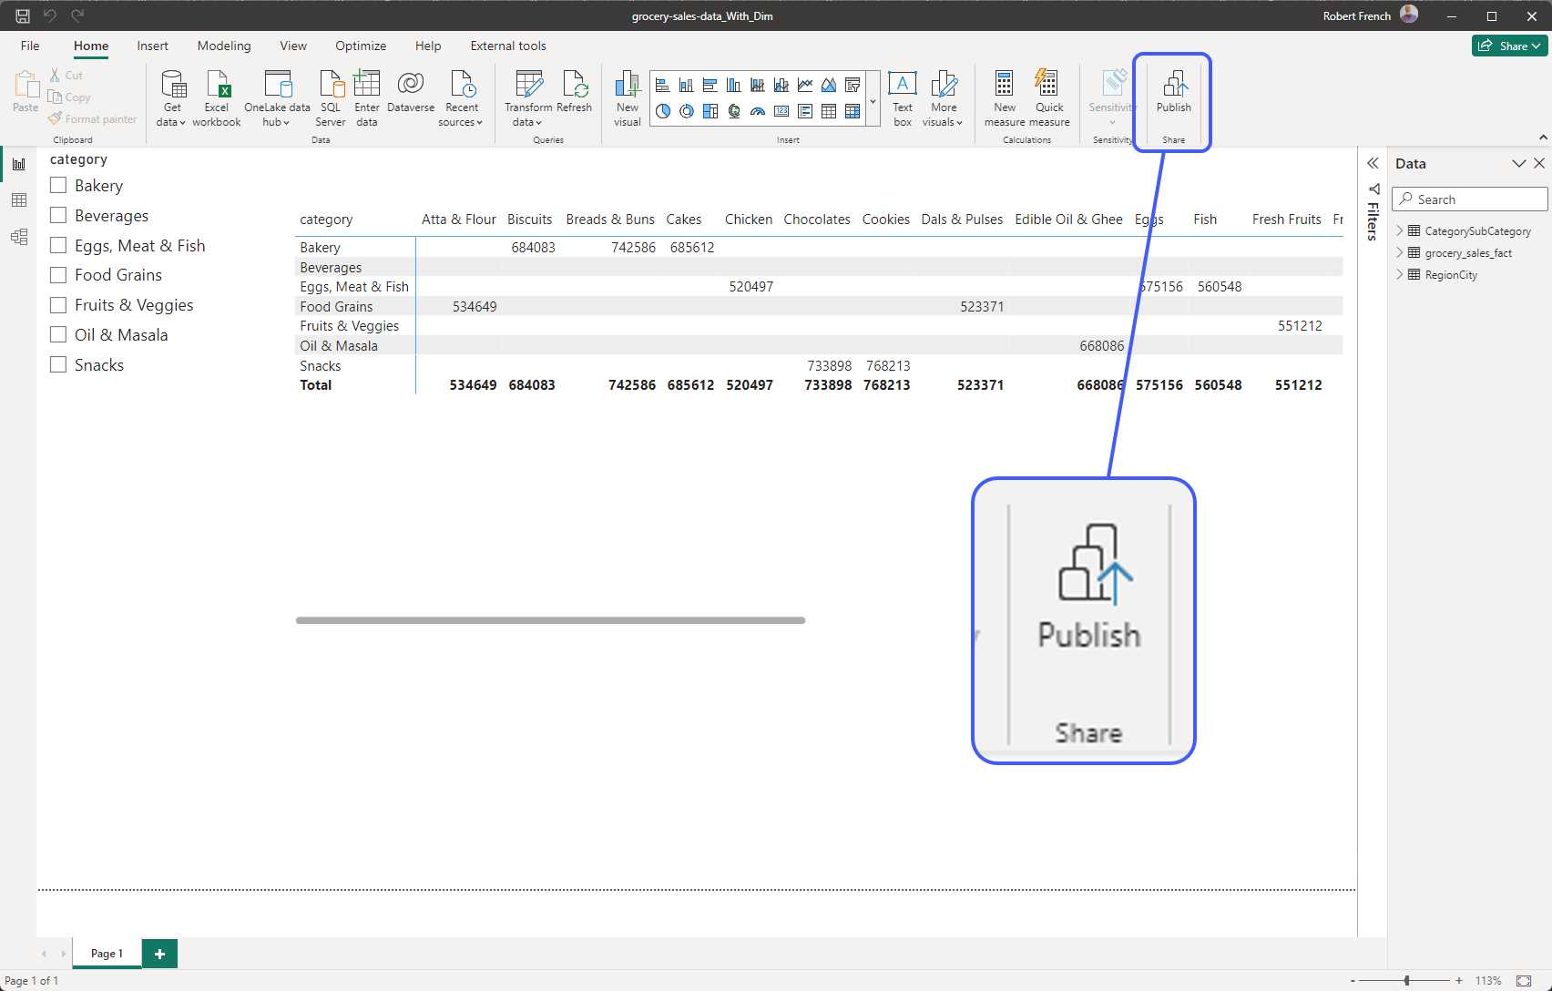

Slide 16
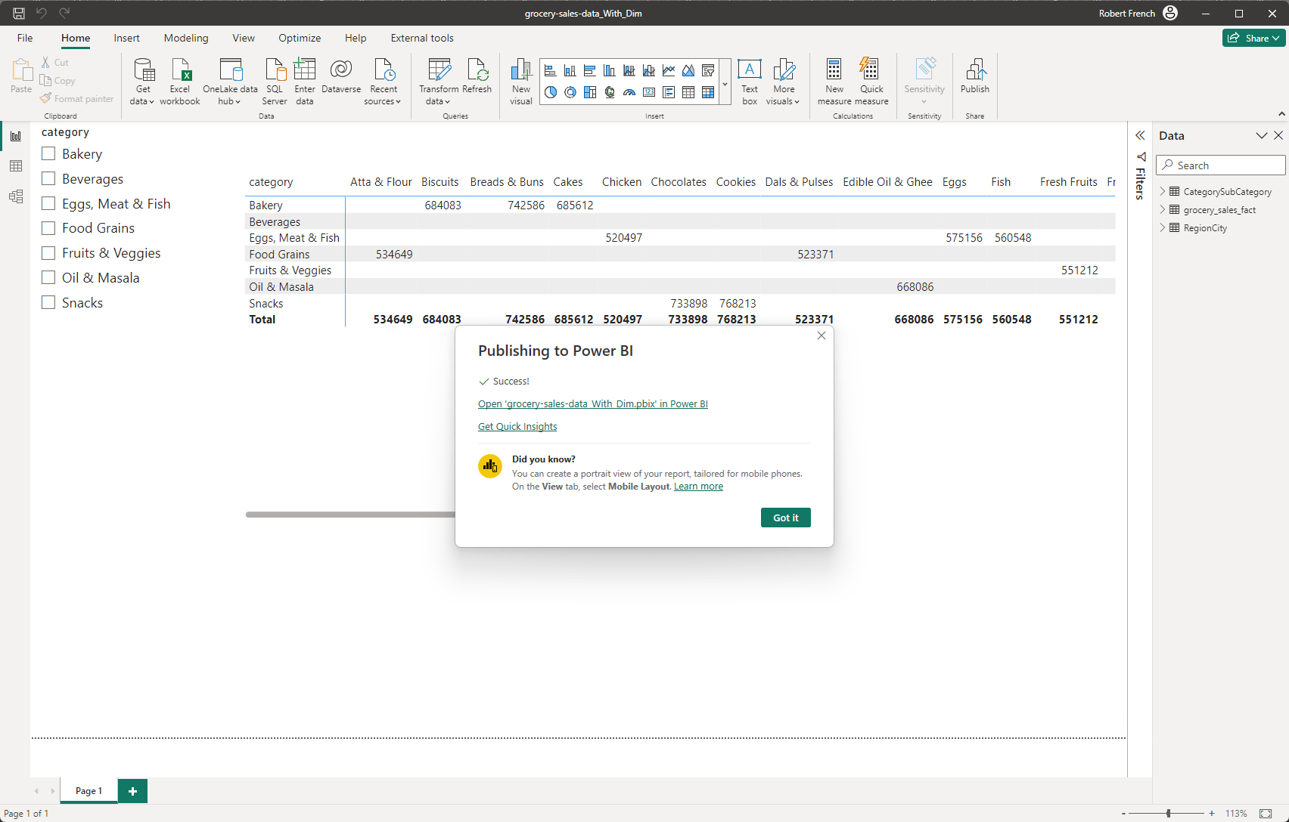

Slide 17
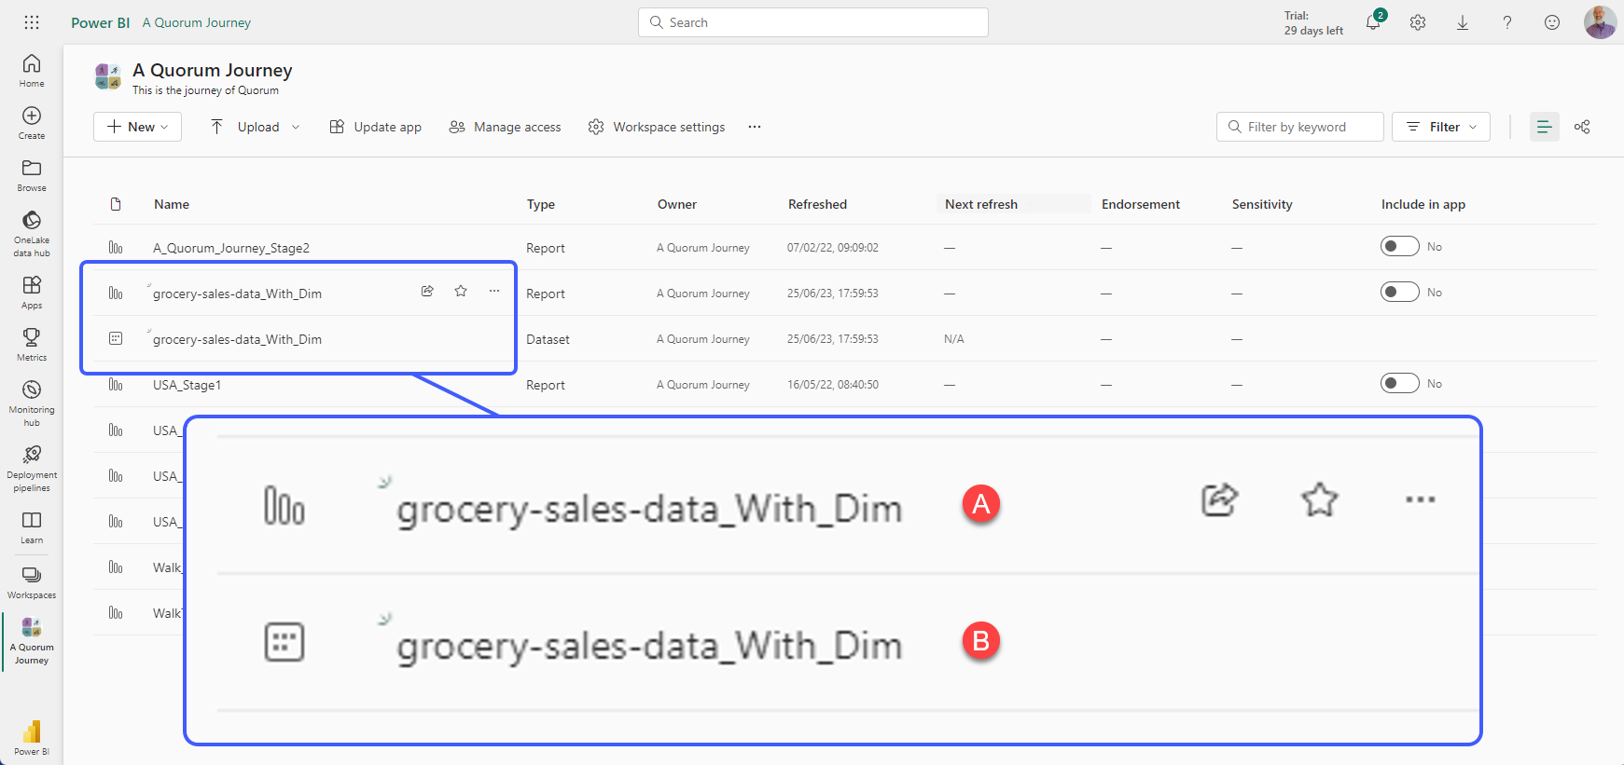

Slide 18
A – Is a thin report only contains visuals
B – Is a Dataset

Slide 20
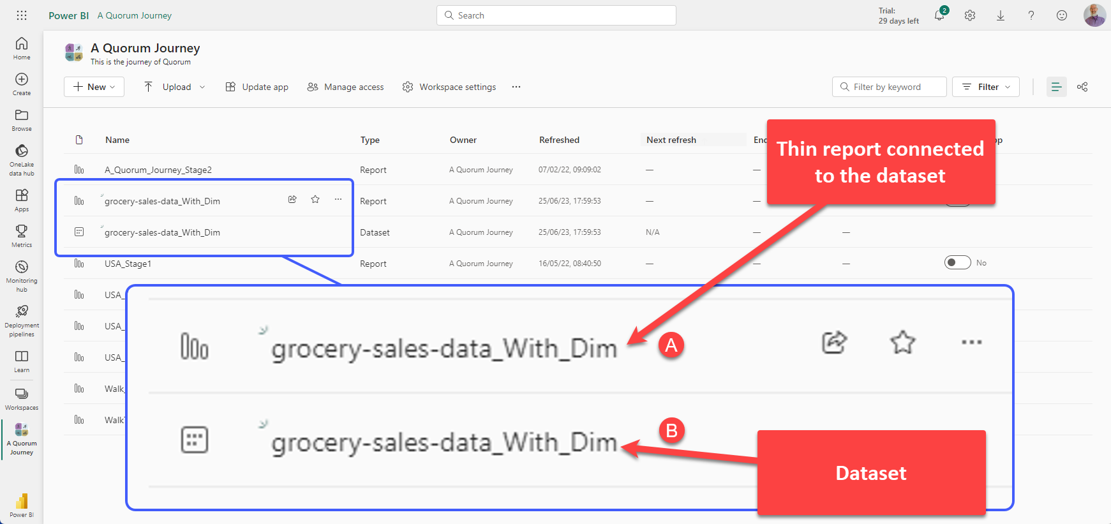

Slide 21


Direct Connection
DataSet
Thin Report
Notes:
There is not data stored in the thin report only visuals.
So when the report with data is deployed to the service it is split into two parts
A dataset and a thin report connected to that dataset

Slide 22
Publish Dataset to the
Power BI Service

Slide 23
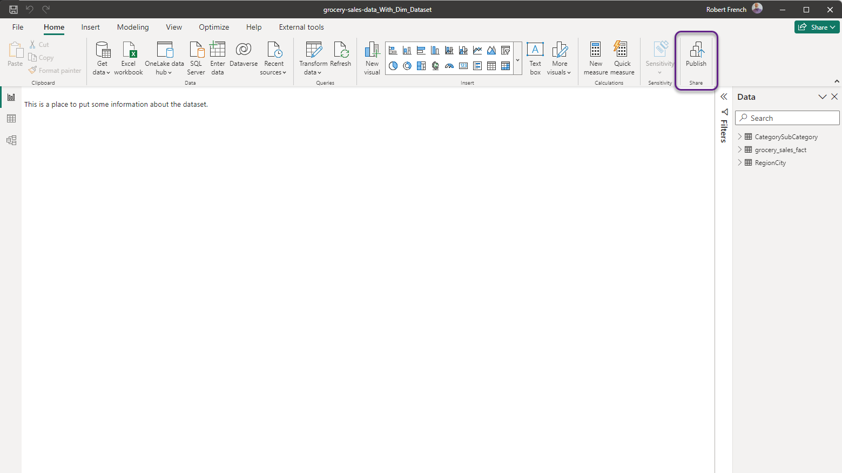

Slide 24
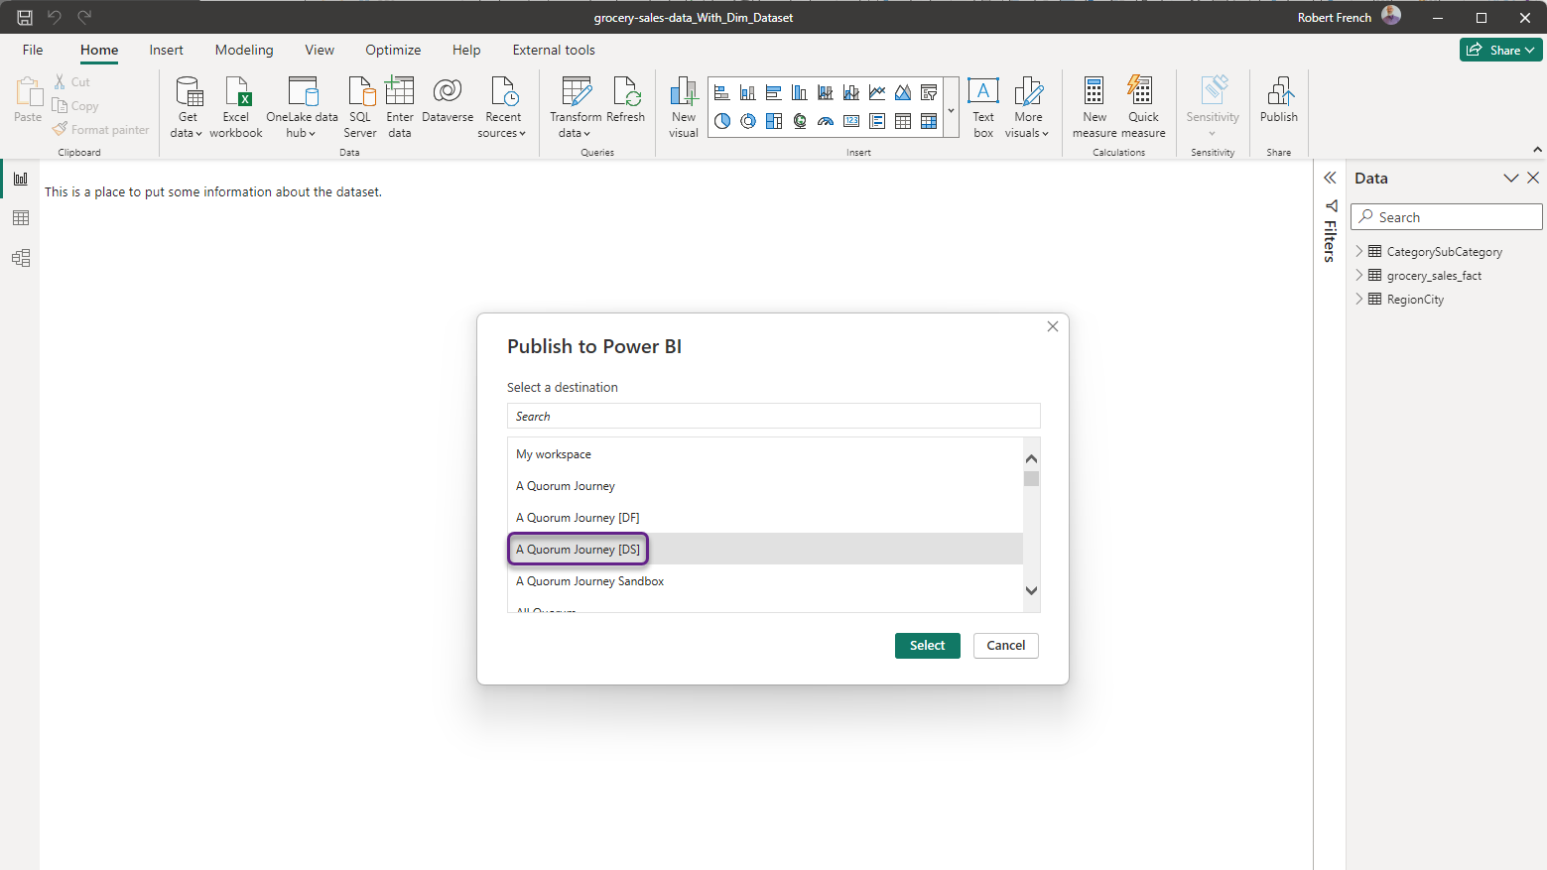

Slide 25
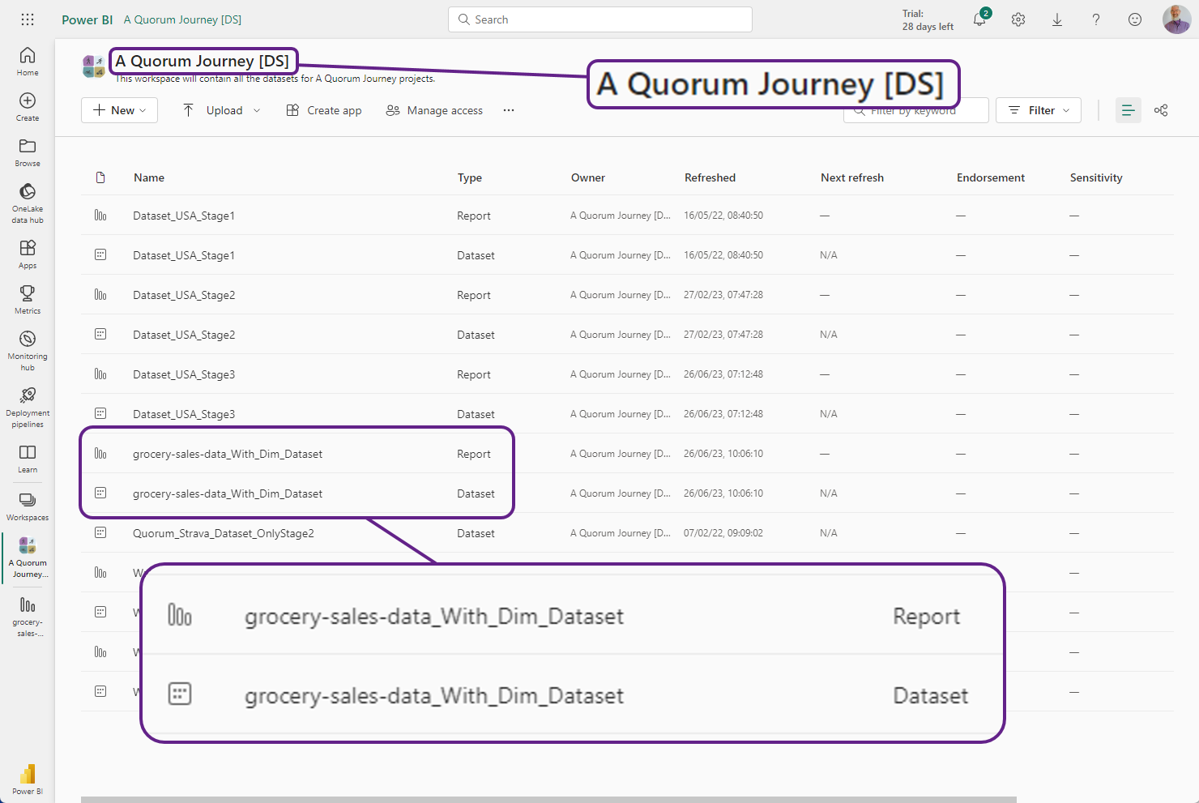

Slide 26

Make a thin report.

Slide 27
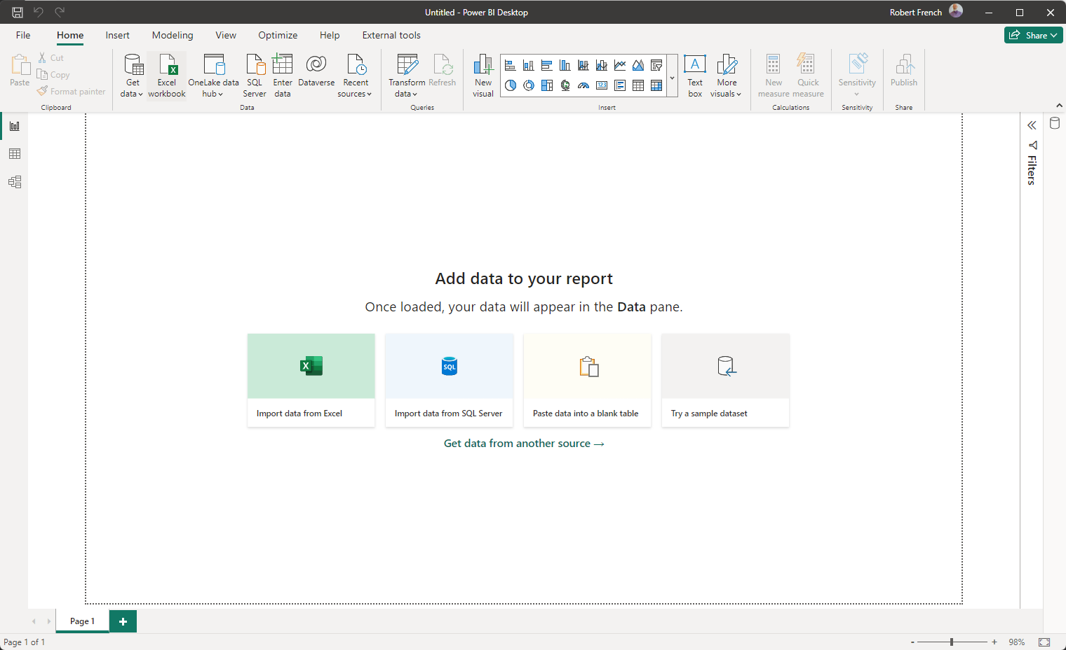

Slide 28
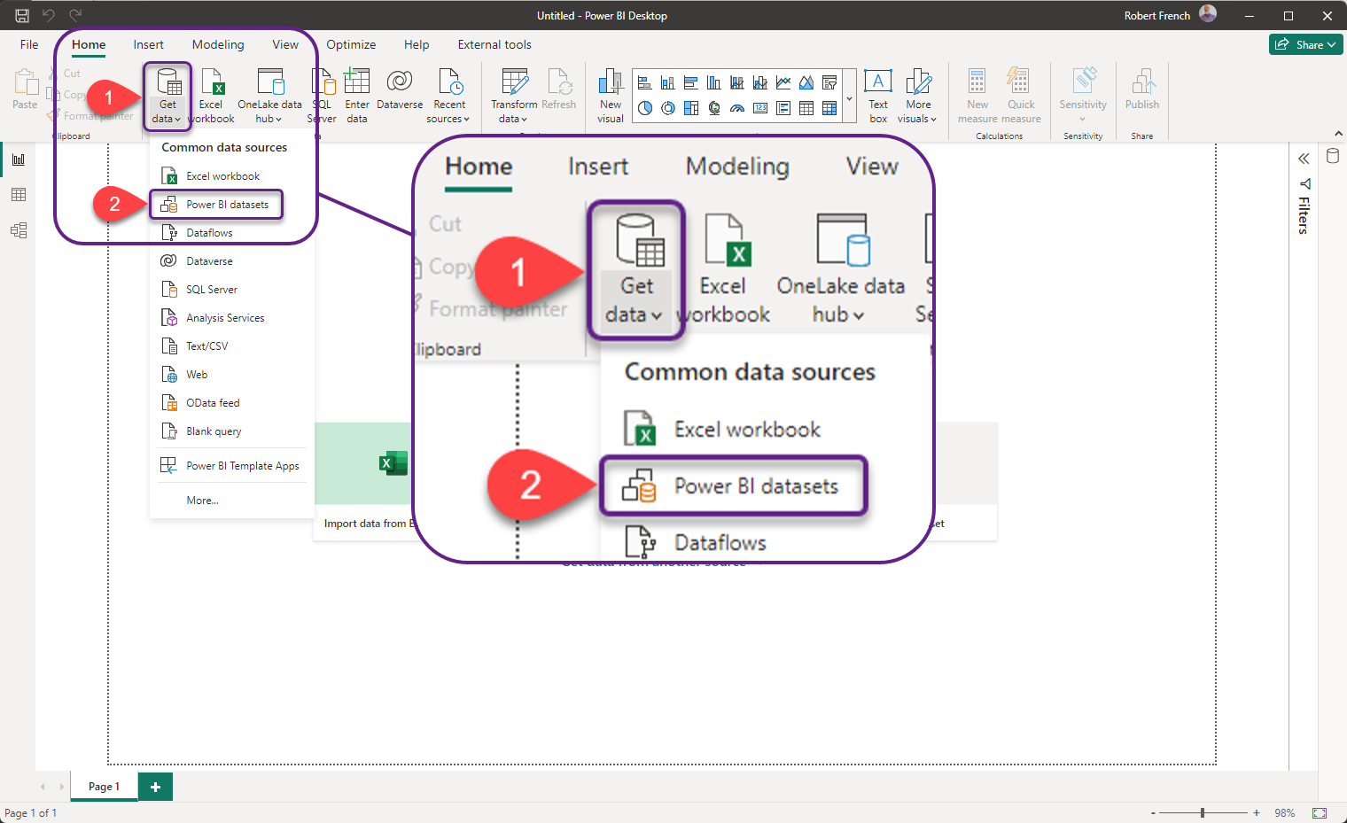

Slide 29
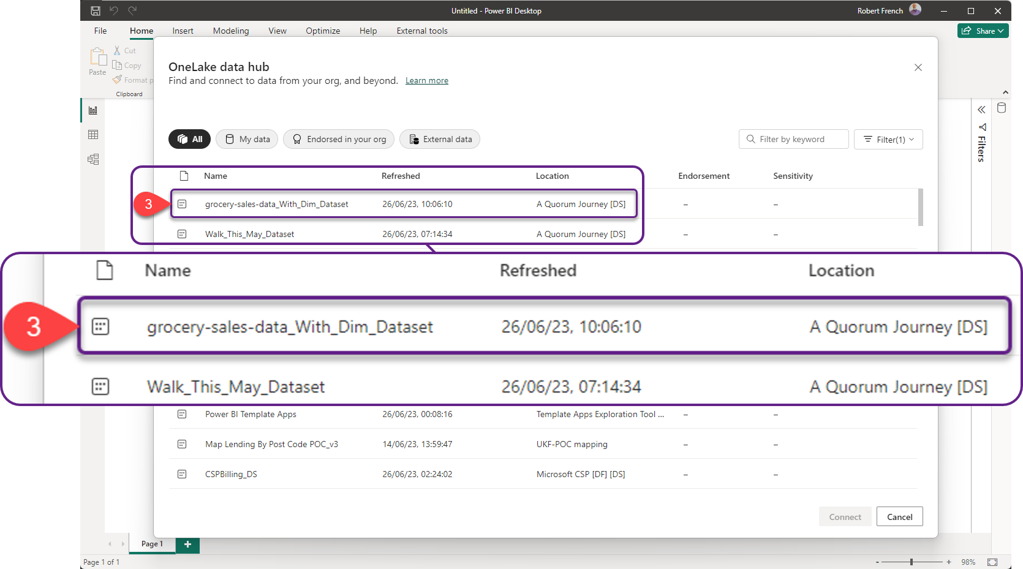

Slide 30
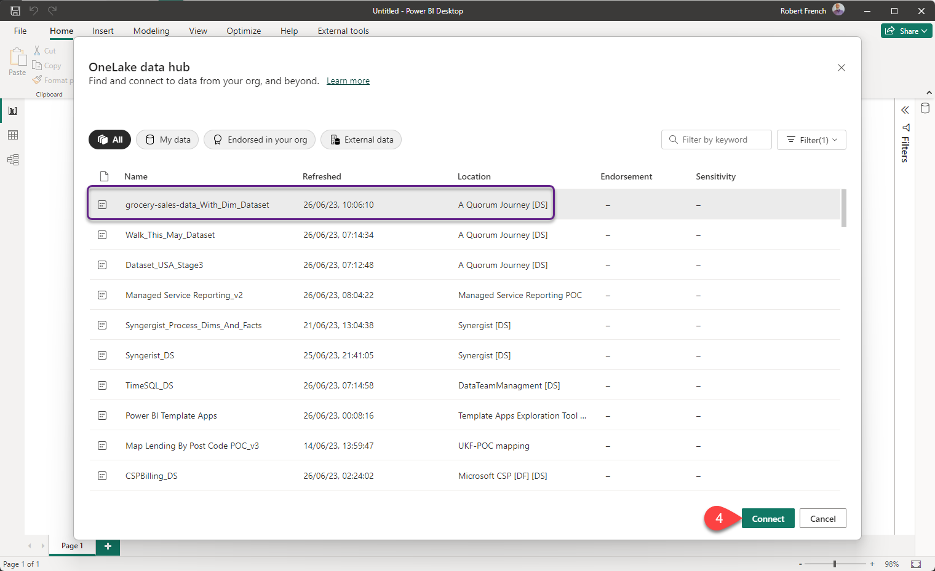

Slide 31
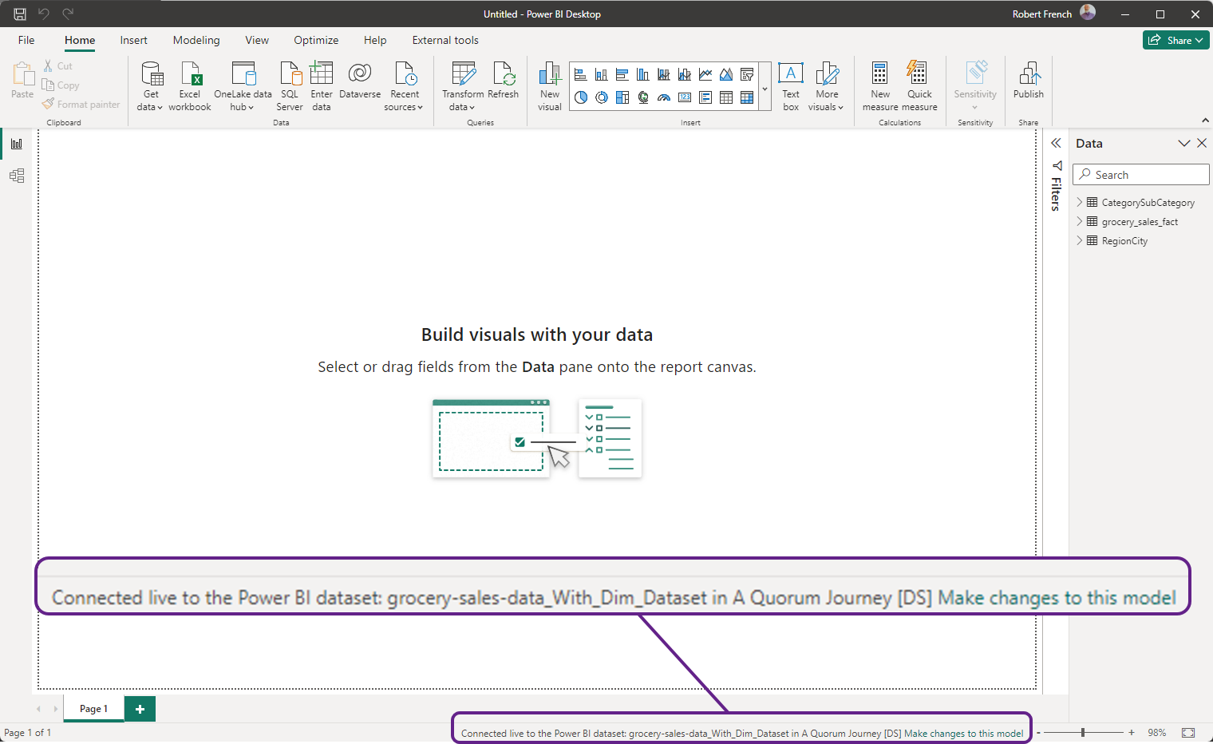

Slide 32
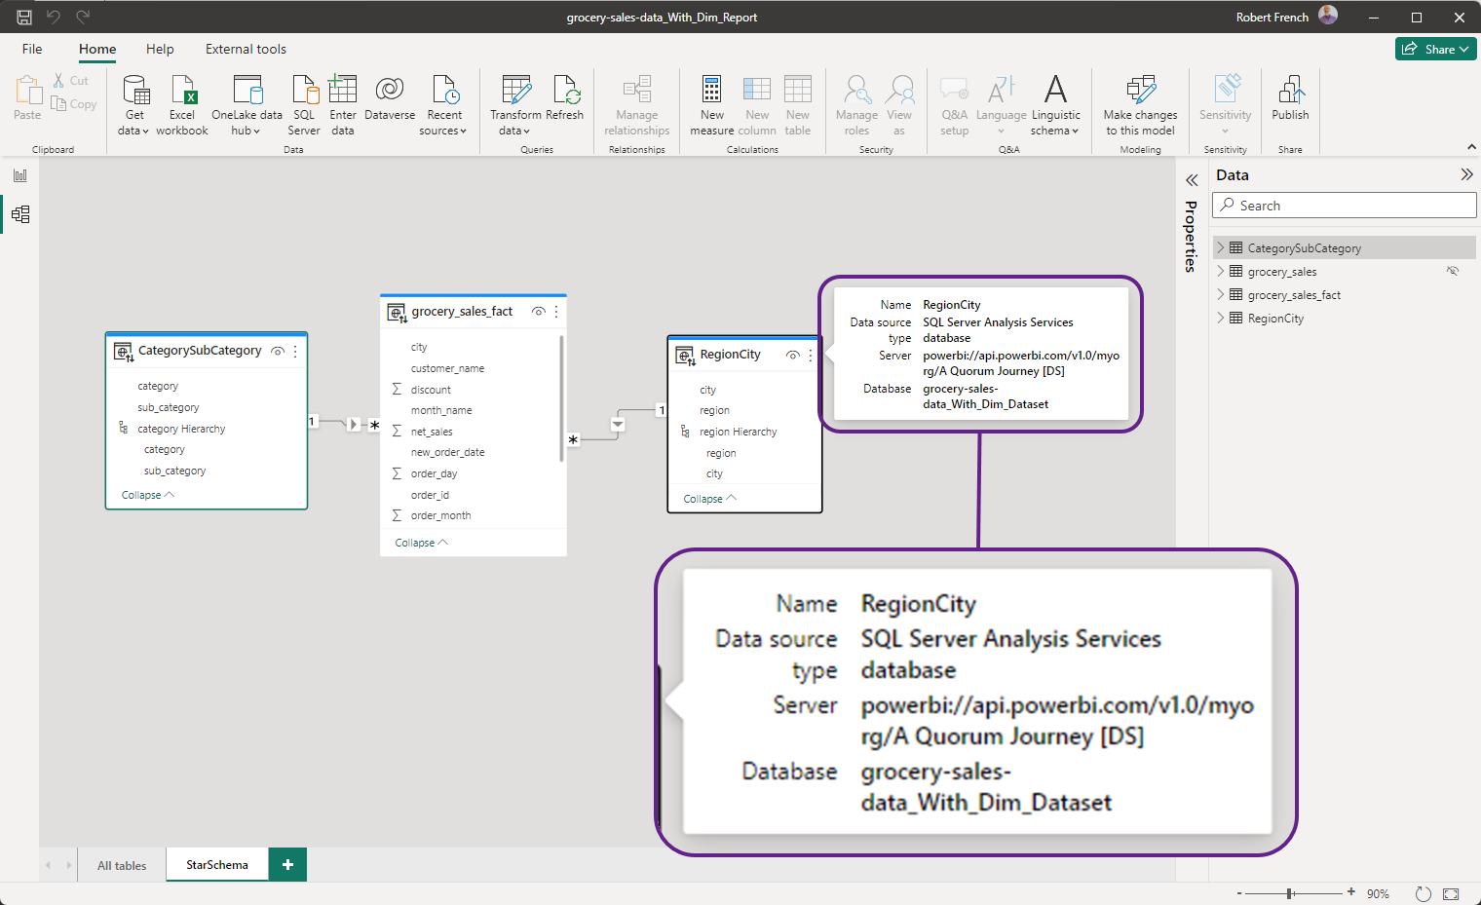

Slide 33
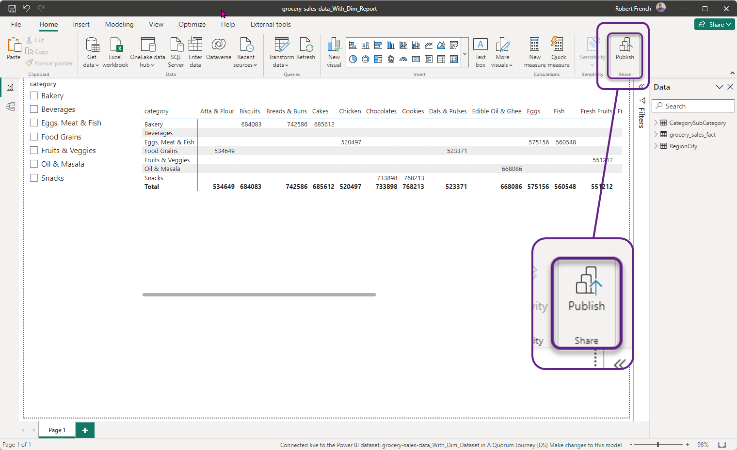

Slide 34
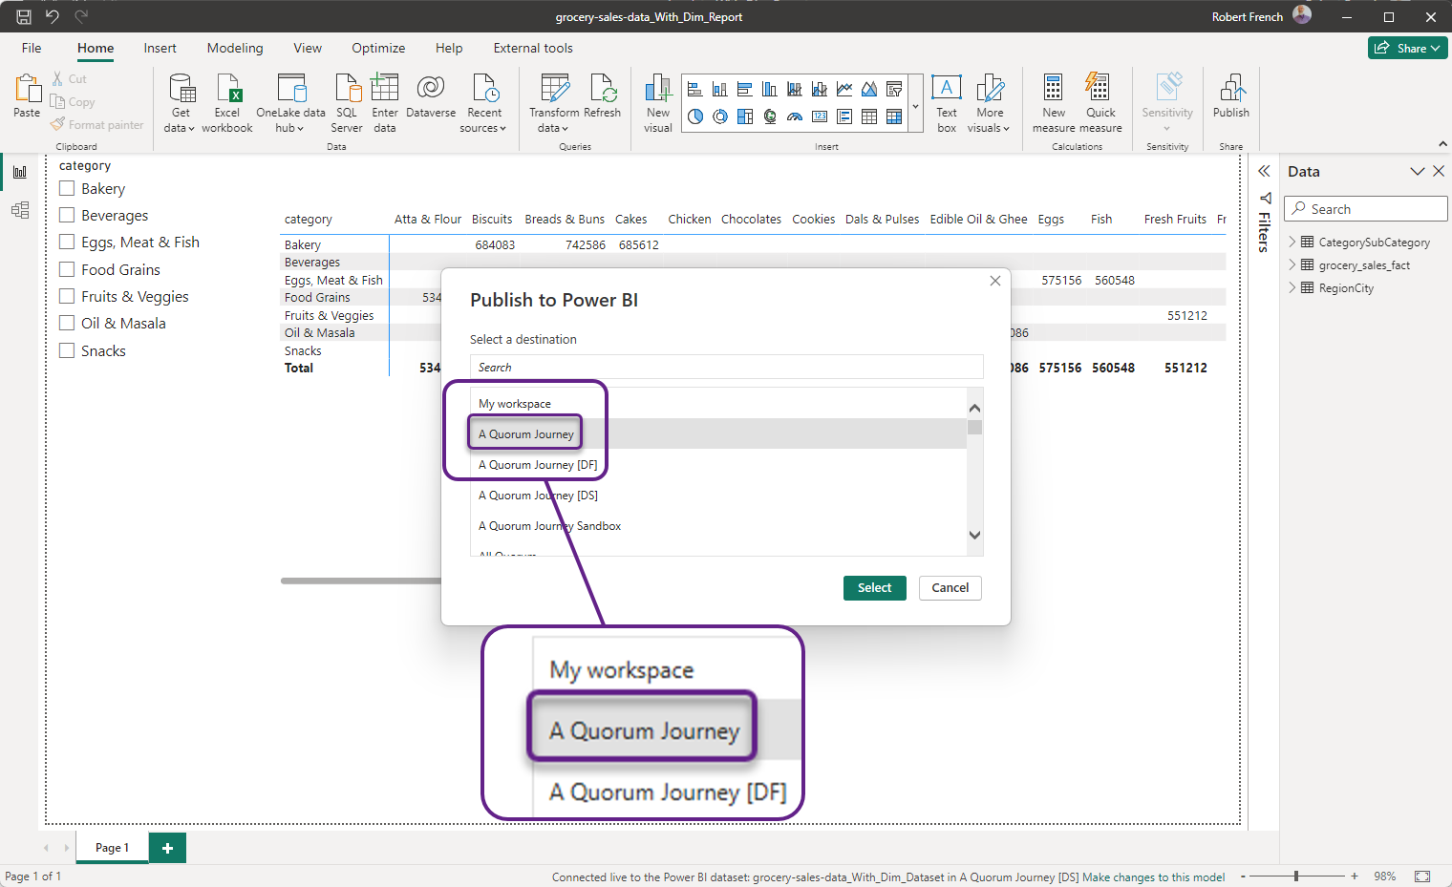

Slide 35
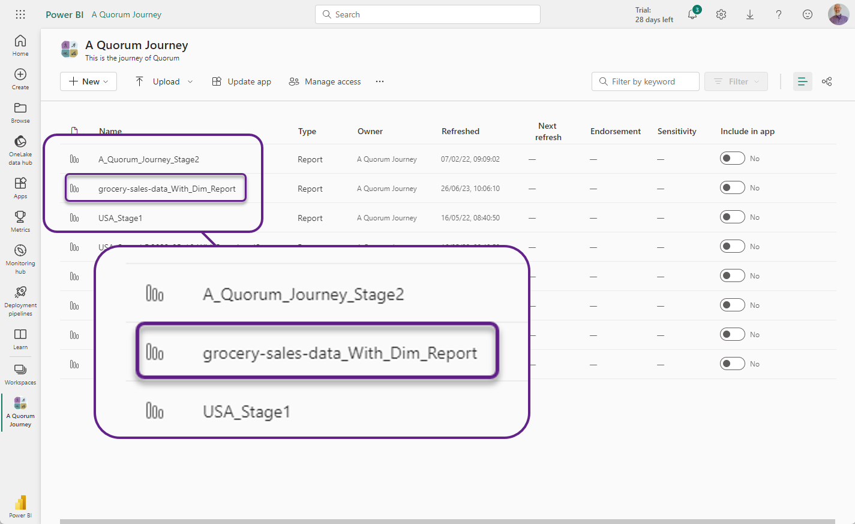

Slide 36
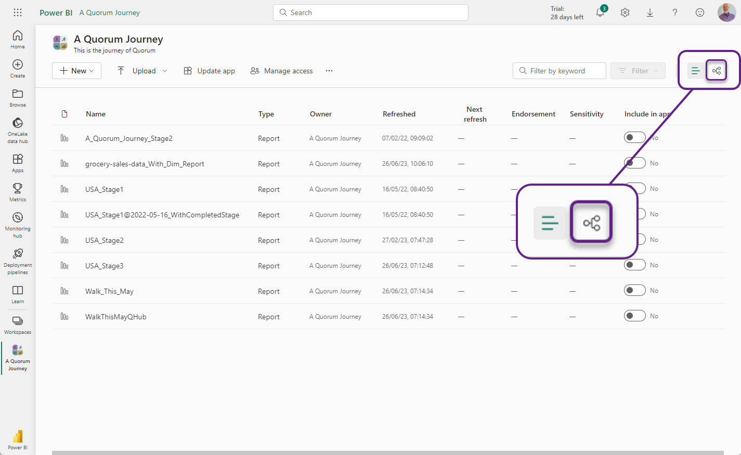

Slide 37
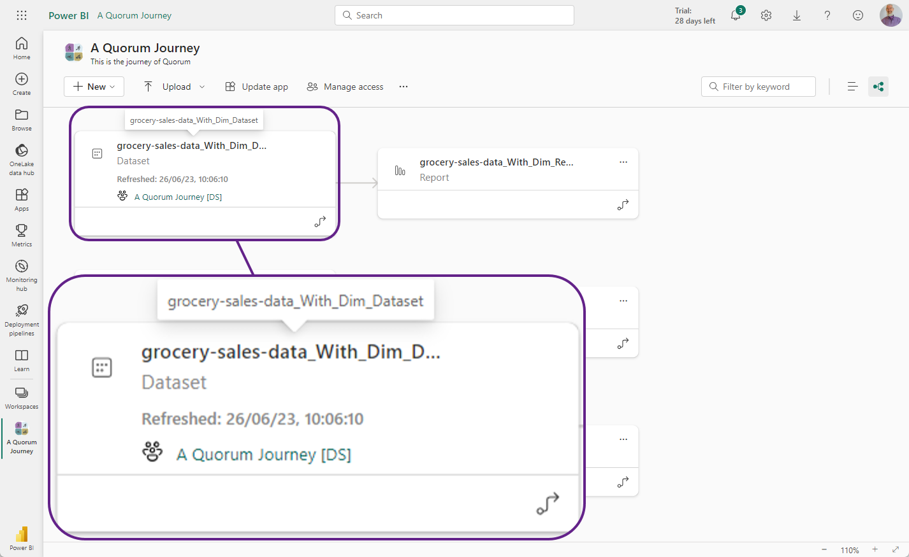
Notes:
Note that the report and the dataset are in completely different workspaces

Slide 38

Notes:
Photo by Miguel Orós on Unsplash
There are other ways to publish reports to the Power BI service

Slide 39
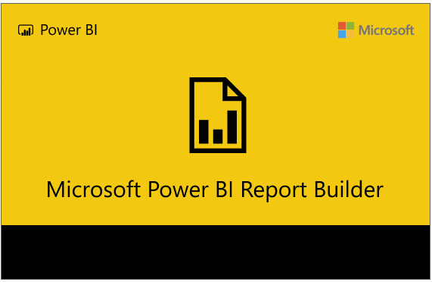

Slide 40
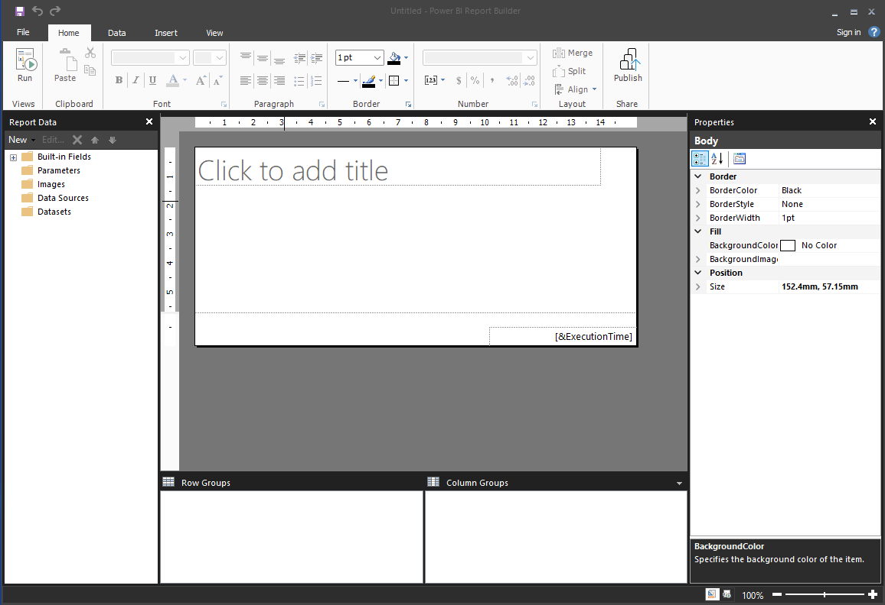

Slide 41
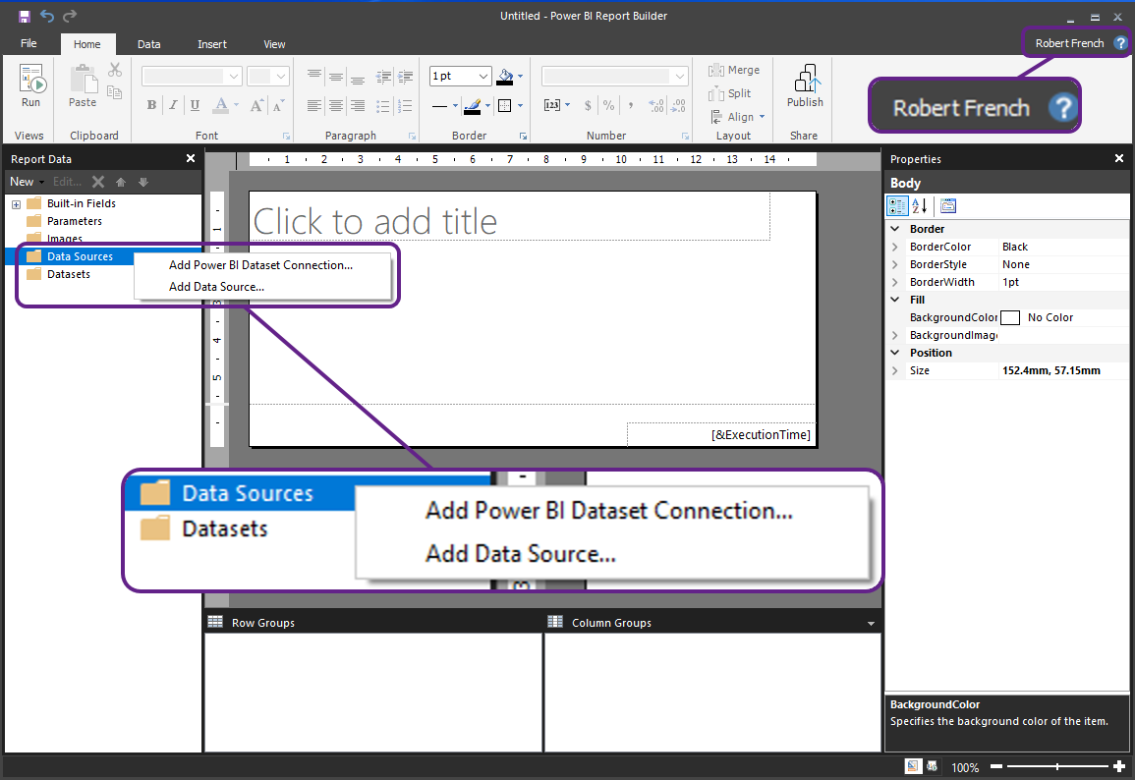

Slide 42
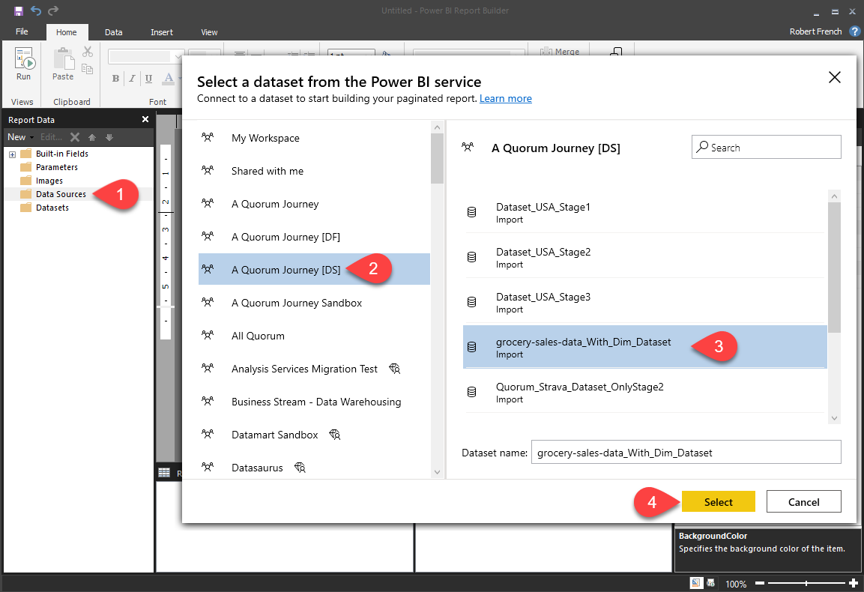

Slide 43
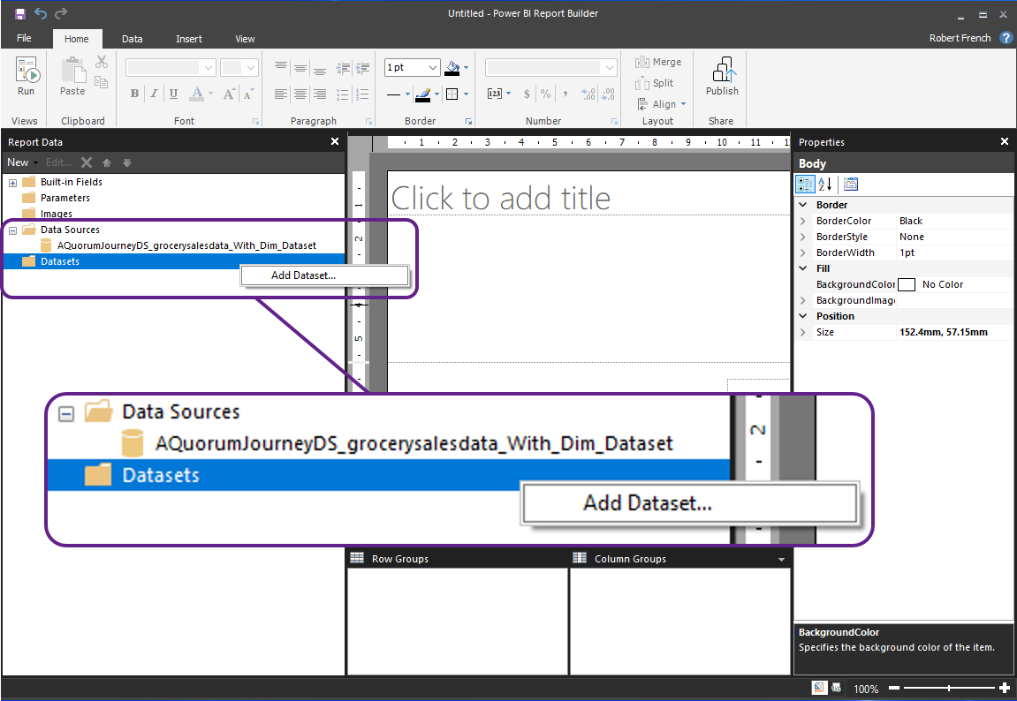

Slide 44
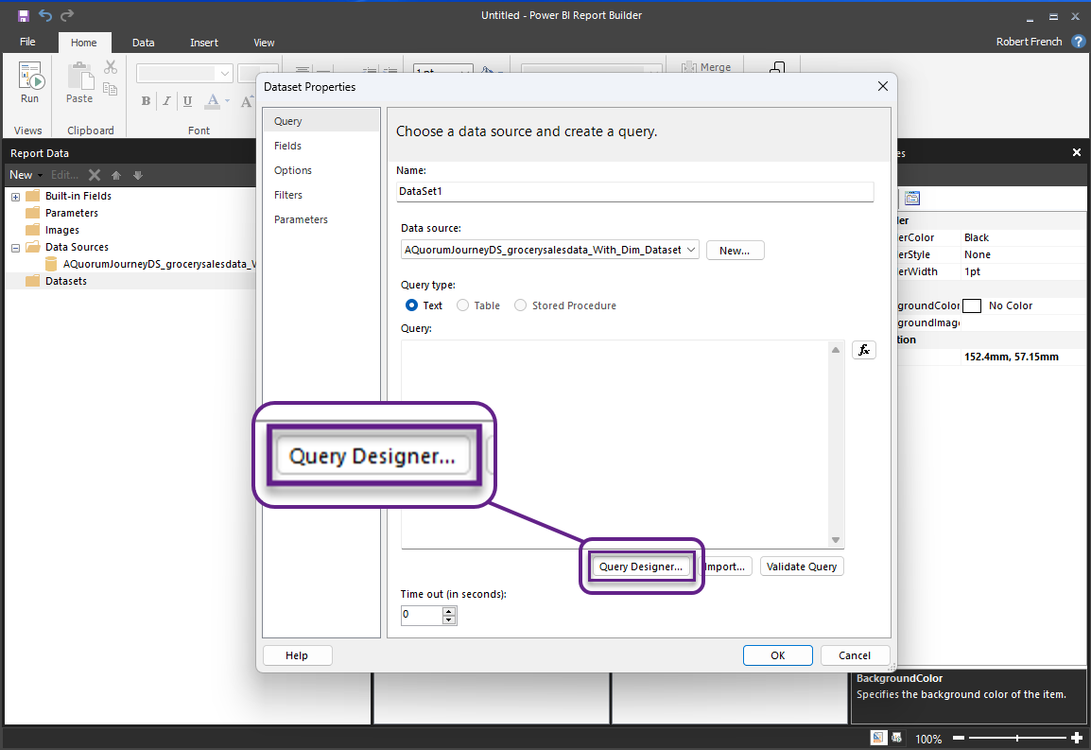

Slide 45
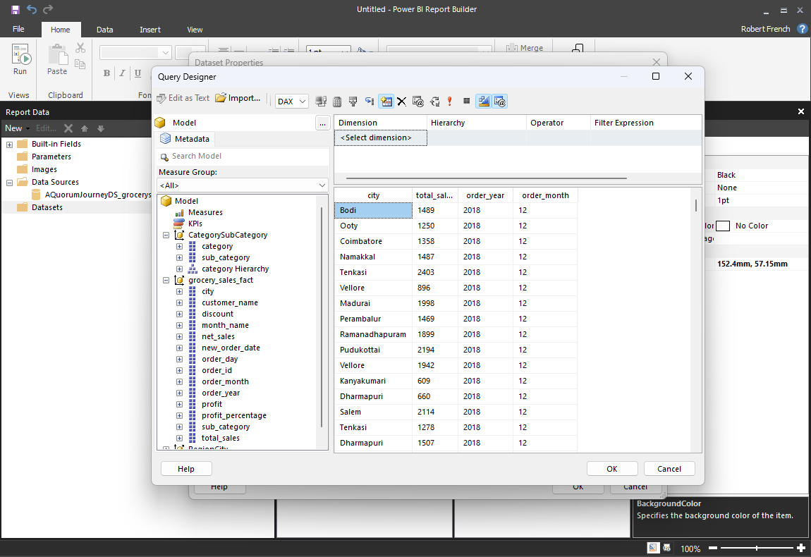

Slide 46
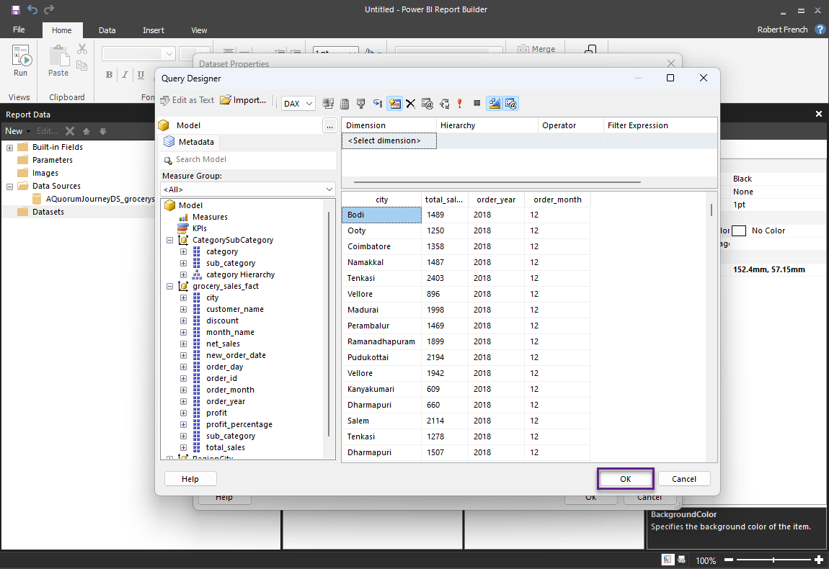

Slide 47
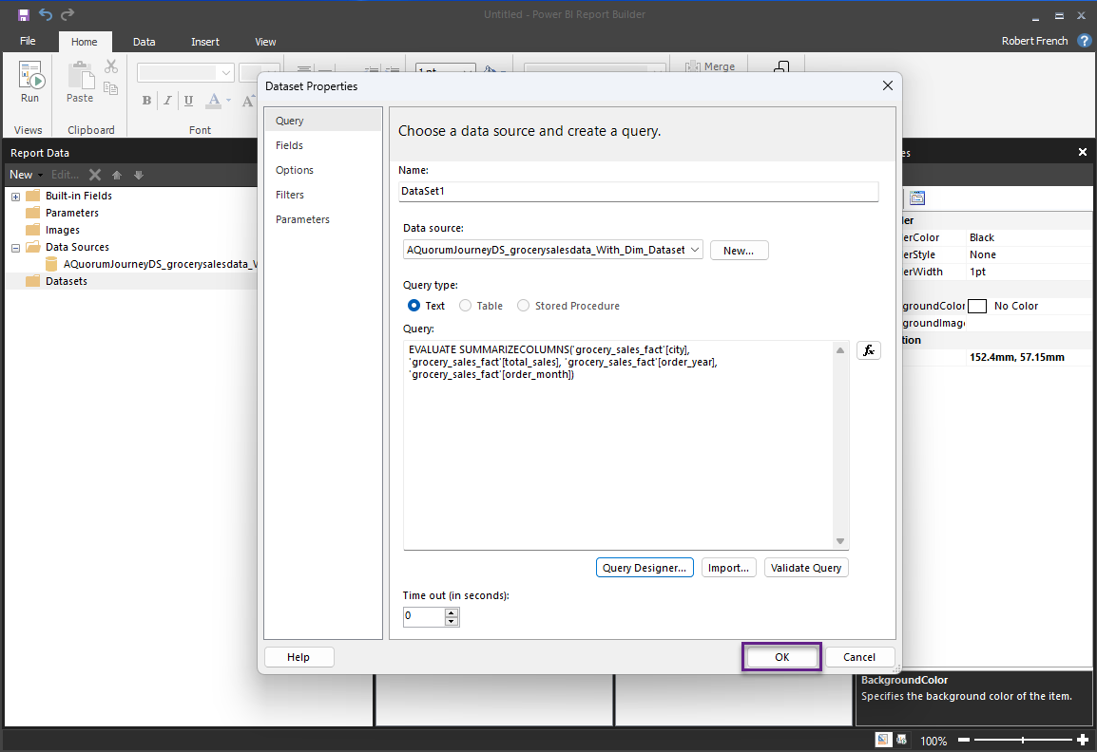

Slide 48
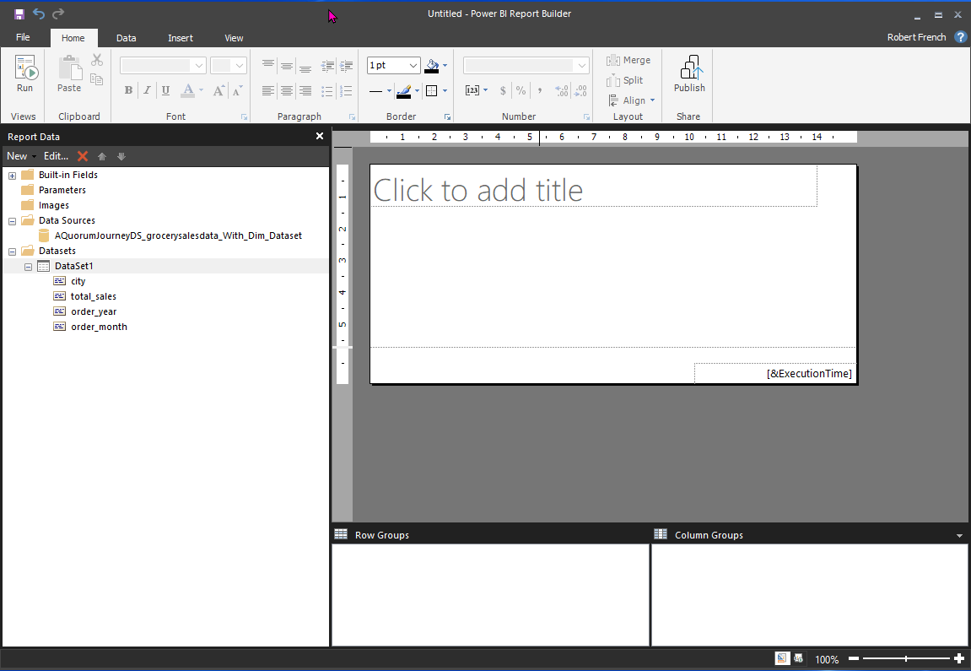

Slide 49
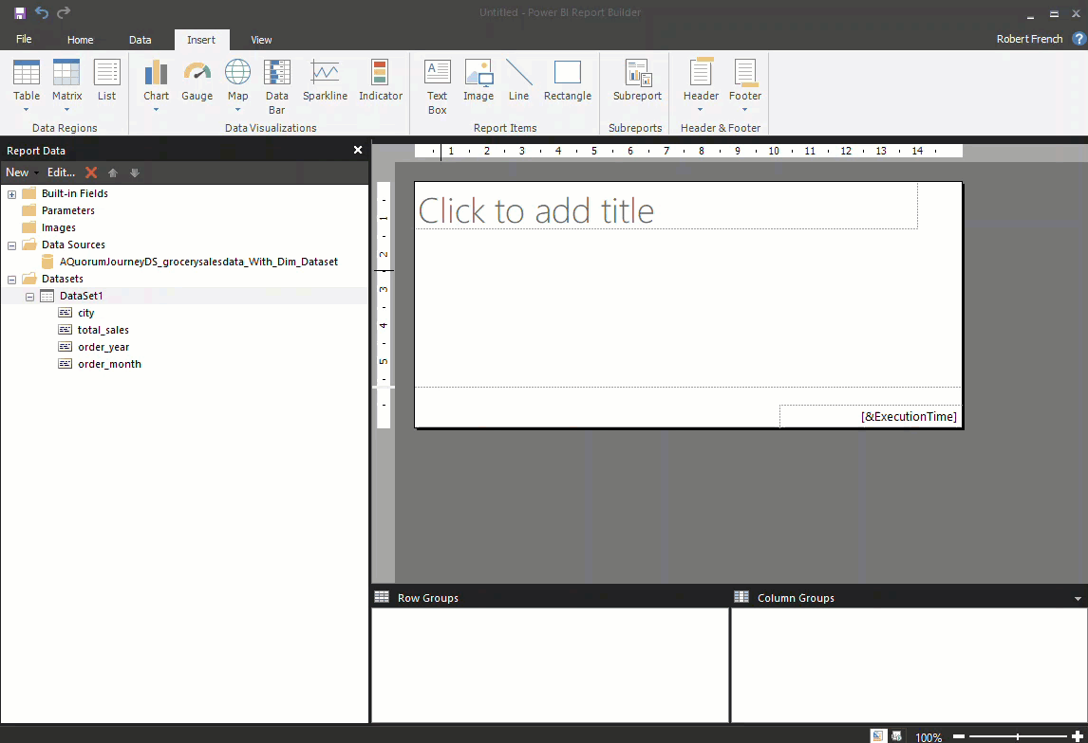

Slide 50
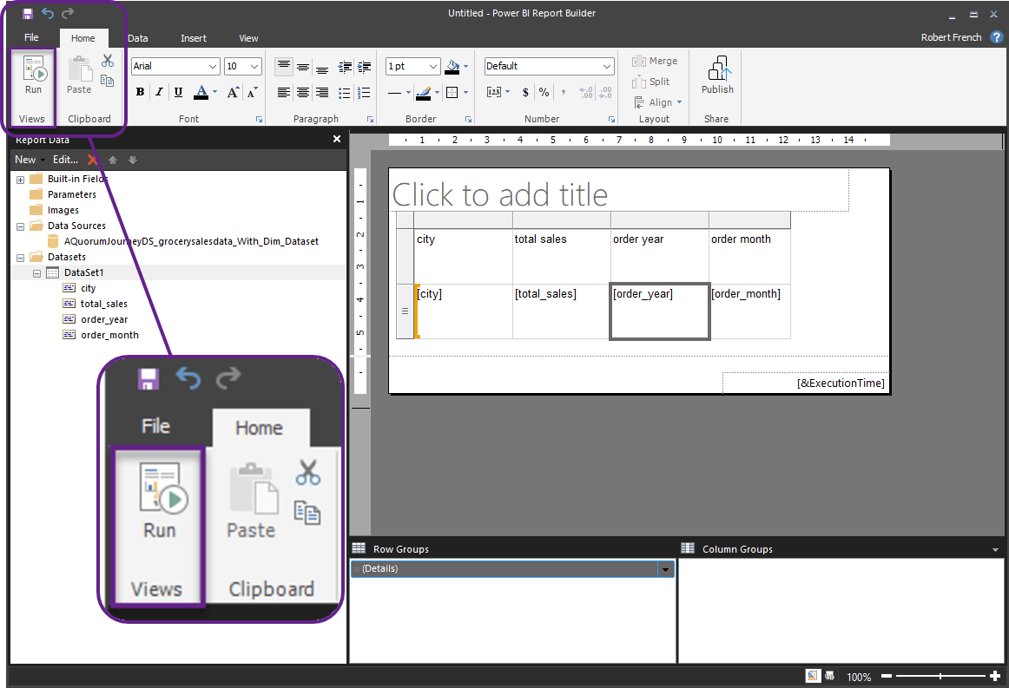

Slide 51
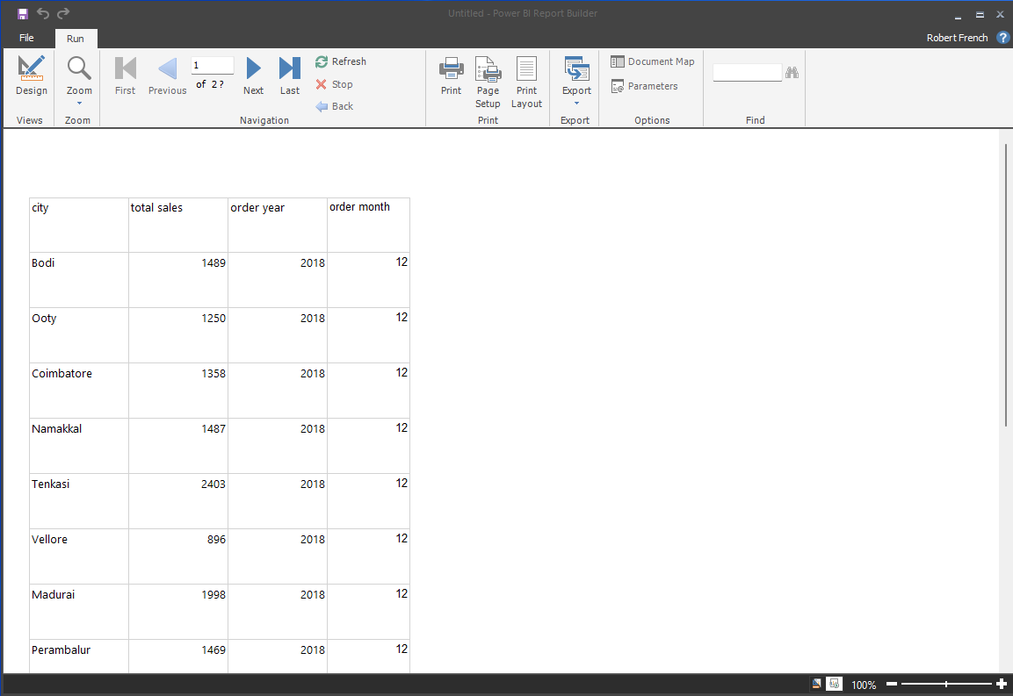

Slide 52
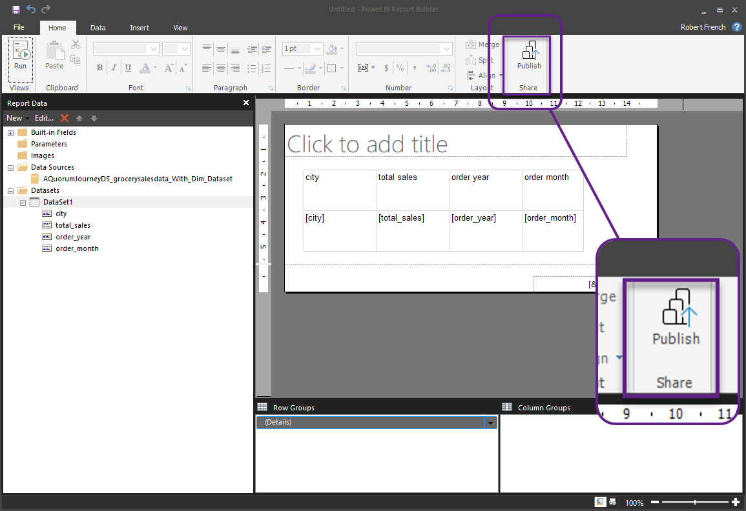

Slide 53
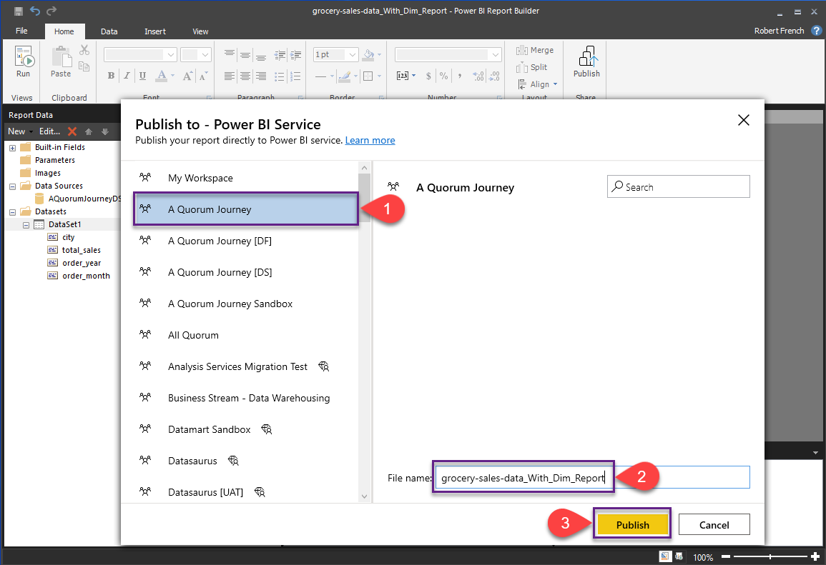

Slide 55
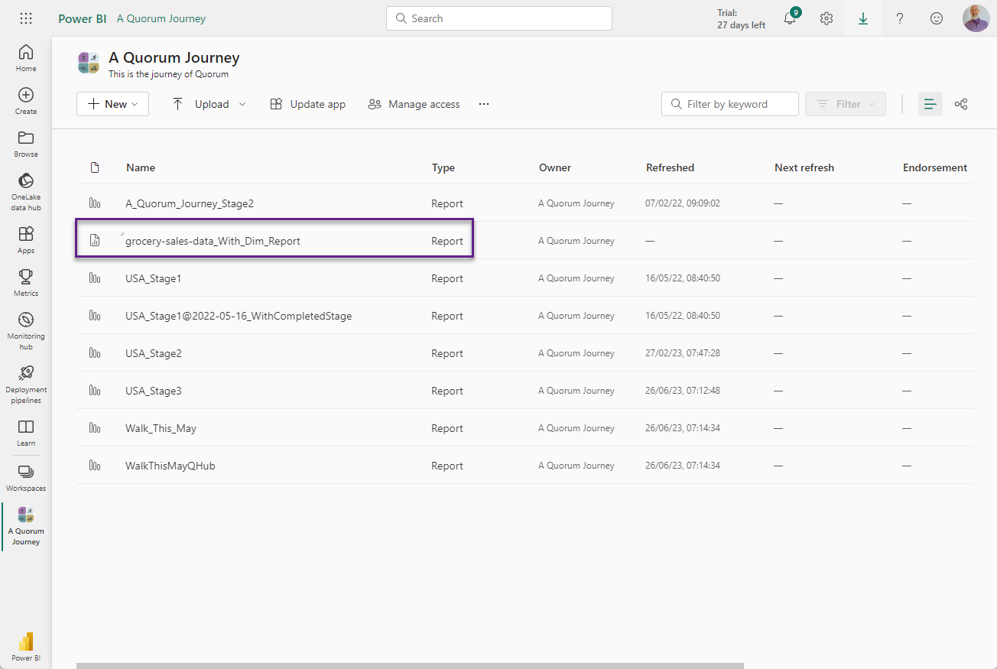

Slide 56
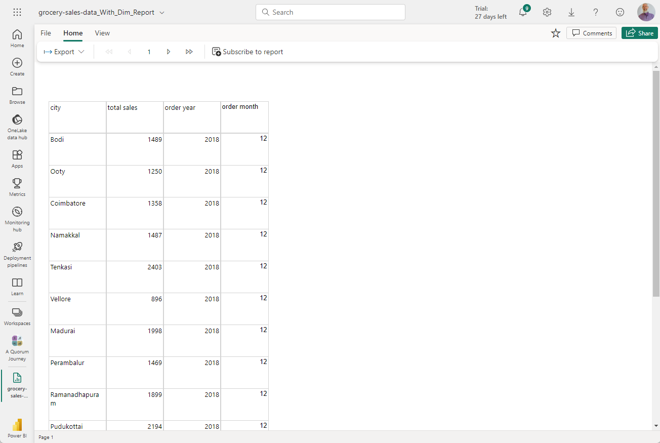

Slide 57

Create Power BI Report in the Power BI service

Slide 58

Notes:
Photo by Vie Studio: https://www.pexels.com/photo/the-phrase-be-aware-on-a-pin-board-7005410/
Require at least contributor role to do this

Slide 59
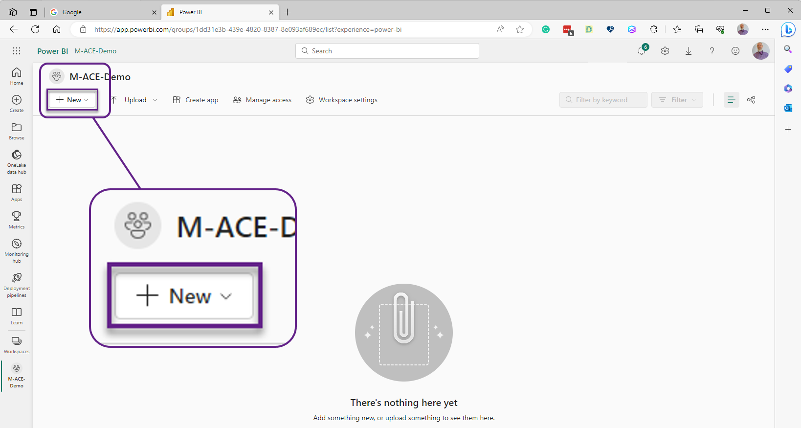

Slide 60
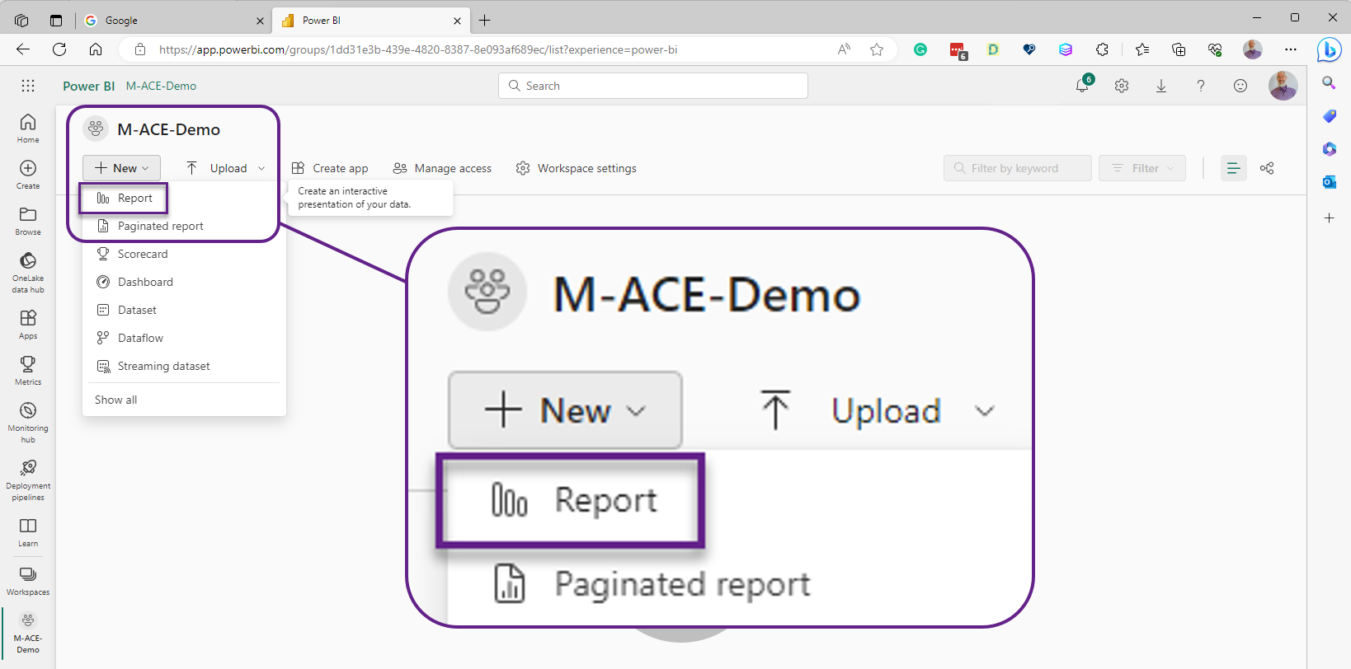

Slide 61
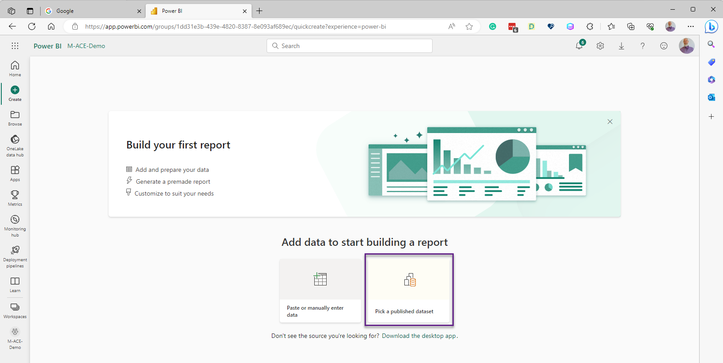

Slide 62
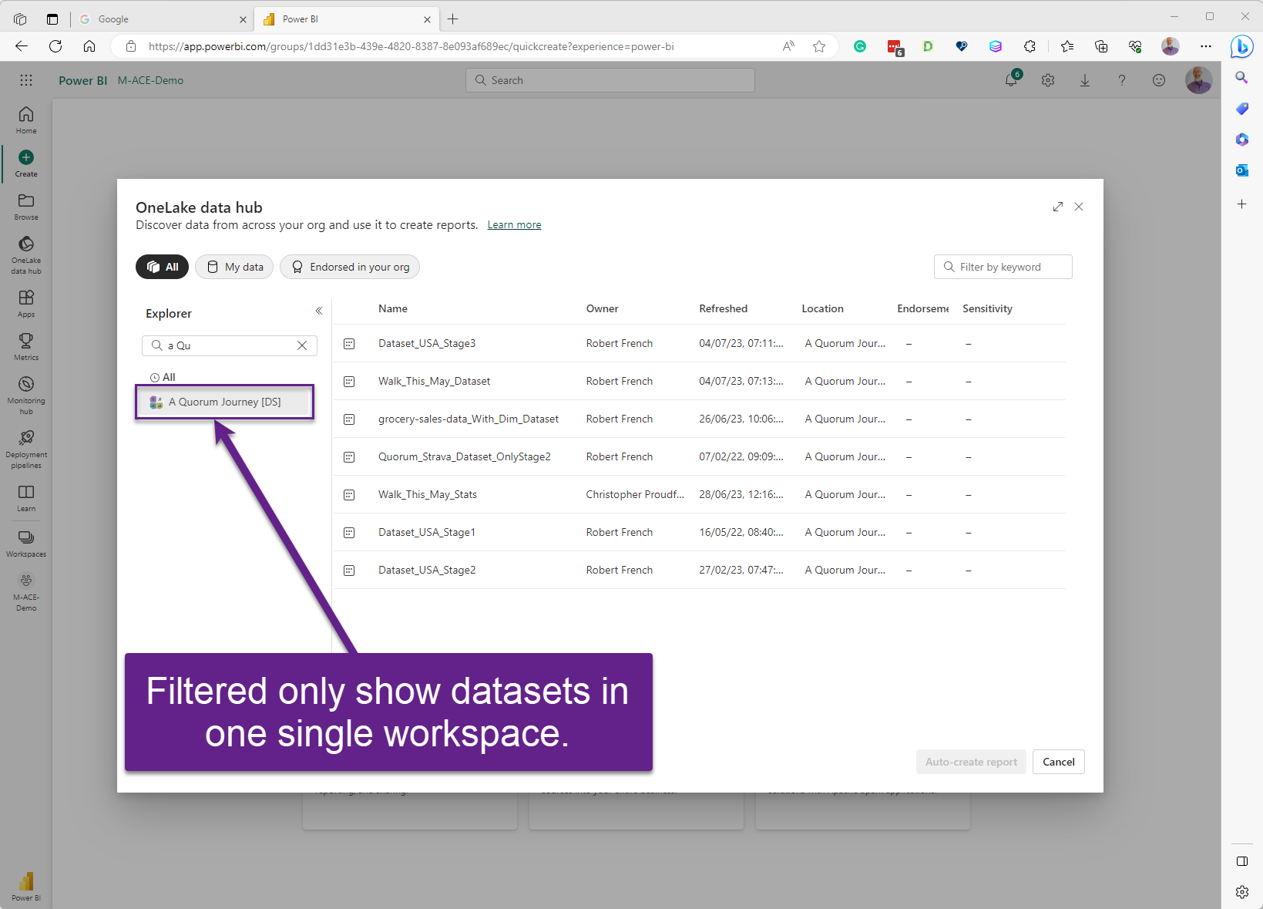

Slide 63


Slide 64


Slide 65


Slide 66


Slide 67


Slide 68


Slide 69


Slide 70
Limitations

Slide 71

Max Desktop 1 GB size
Notes:
Photo by patricia serna on Unsplash
Max size of power bi desktop file that can be uploaded is 1gb

Slide 72

Max 8 per day
Notes:
8 refreshes per day

Slide 73

Max data model size of 10gb
(in the Power BI Service)
Notes:
Photo by <a href="https://unsplash.com/@rhysatwork?utm_source=unsplash&utm_medium=referral&utm_content=creditCopyText">Rhys Moult</a> on <a href="https://unsplash.com/photos/7eaFIKeo1MQ?utm_source=unsplash&utm_medium=referral&utm_content=creditCopyText">Unsplash</a>

Slide 74

Only share with Power BI Pro license users
Notes:
Photo by <a href="https://unsplash.com/@alienowicz?utm_source=unsplash&utm_medium=referral&utm_content=creditCopyText">Artur Rutkowski</a> on <a href="https://unsplash.com/photos/GdTLaWamFHw?utm_source=unsplash&utm_medium=referral&utm_content=creditCopyText">Unsplash</a>

Slide 75
Only share with Power BI Pro license users
Notes:
Photo by <a href="https://unsplash.com/@alienowicz?utm_source=unsplash&utm_medium=referral&utm_content=creditCopyText">Artur Rutkowski</a> on <a href="https://unsplash.com/photos/GdTLaWamFHw?utm_source=unsplash&utm_medium=referral&utm_content=creditCopyText">Unsplash</a>

